Slide 1


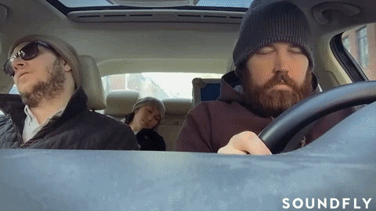
DRIVER DROWSINESS DETECTION SYSTEM
18DCS007 - RUDRA BARAD
18DCS024 - HET GALIA
18DCS030 - MANAN JOSHI
Supervisor : Prof. Krishna Patel
7CSE1
Domain : ML & DL
SOFTWARE GROUP PROJECT

Slide 2
TABLE OF CONTENTS
01
02
INTRODUCTION
EXISTING SYSTEM
03
04
TECHNOLOGY USED
WORKFLOW

Slide 3
01
INTRODUCTION

Slide 4
DRIVER DROWSINESS DETECTION SYSTEM
More than 30% road accidents are due to driver's sleepiness or fatigue. The driver loses control of the vehicle when he falls asleep which leads to loss of many lives.
This project can help to save lives and prevent accidents using deep learning. There will be a camera in front of the driver face which will detects the driver's face using deep learning and when a sleeps while driving it will give a warning and start the alarm which can prevent accidents.

Slide 5
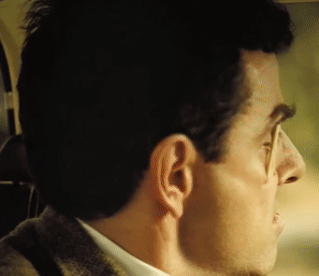
WHAT IT WILL OFFER?
System is designed to avoid accidents.
A sound/audio will be played if the driver is found drowsy.
As a result of which driver will be alerted and won’t feel sleepy. (PS. System is not as effective as the one which is used by Mr Bean.)

Slide 6
02
EXISTING SYSTEMS

Slide 7
There are 4 types of systems available on Driver Drowsiness Detection:-
Physiological analysis, using body sensors to detect brain activity , heart rate etc.
Lane motion sensing system, using lane monitoring cameras.
Detection systems based on Facial Feature Extraction(FFE).
Steering angle sensor analysis based systems.
Notes:
CNN which is deep learning base algorithm.
We found many research paper and article reg the same and basically this process involves three stages: Pre-processing, Feature Extraction and Classification
Steering Wheel Movement (SWM) which is measured using steering angle sensor and it is a used for detecting the level of driver drowsiness. Using an angle sensor mounted on the steering column, the driver’s steering behaviour is measured.
Eg hindawi.com, Bosch Mobility System

Slide 8
03
TECHNOLOGY

Slide 9
TECHNOLOGY USED
OpenCV
Keras
TensorFlow
Used for detection of face and eye of person
Build classified model
Used as a backend for keras
Notes:
Keras is an open-source software library that provides a Python interface for solving machine learning problems.
Tensorflow which an end to end open source software library for ML which we will use as background for keras.

Slide 10
ALGORITHMS USED
CNN
Transfer Learning
A Convolutional neural network (CNN) is a neural network that has one or more convolutional layers and are used mainly for image processing, classification, segmentation and also for other auto correlated data.
Transfer learning (TL) is a research problem in machine learning (ML) that focuses on storing knowledge gained while solving one problem and applying it to a different but related problem

Slide 11
04
WORKFLOW

Slide 12
Step 1
Step 3
Step 5
Take image from camera
Detect eyes
Percentage
Of
Drowsiness
Step 2
Step 4
Detect face
Classify eye open or not

Slide 13
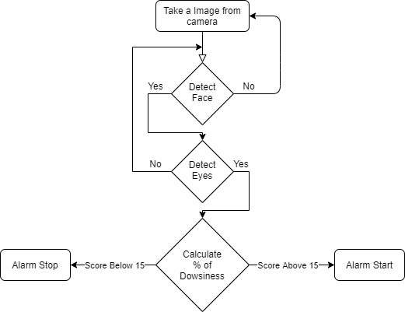
FLOW CHART

Slide 14
System Analysis
Transfer Learning
02
01
CNN
DATASET
MRL Eyes Dataset
TRAINING ACCURACY
79%
VALIDATION ACCURACY
81%
DATASET
Datafliar FF Custom
TRAINING ACCURACY
99.6%
VALIDATION ACCURACY
95%

Slide 15
THANK YOU

